Slide 1
Informed Search

Slide 2
Instructional Objectives
Understand what is heuristic function
Be able to design heuristic function for a given problem
Be able to prove that if A* uses an admissible heuristic function, it will produce an optimum solution
Should learn how to compare two heuristic functions

Slide 3
Informed Search
We have seen that uninformed search methods that systematically explore the state space and find the goal
  Inefficient in most cases
  Informed search methods use problem specific knowledge, are more efficient

Slide 4
Heuristics
Heuristic: “ rule of thumb”
“ Heuristics are criteria, methods or principles for deciding which among several alternative courses of action promise to achieve the most effective in order to achieve some goal” – Judea Pearl
Can use heuristics to identify the most promising search path

Slide 5
Example of Heuristic Function
A heuristic function at a node n is an estimate of the optimum cost from the current node to a goal. Denoted by h(n)
h(n) = estimated cost of the cheapest path from node n to a goal node
Example:

Slide 6
Heurustic Example
8-puzzle
No. of tiles out of place
Manhotton Distance

Slide 7
Informed Search Strategies
• Best-first search
– Greedy search
– A* search
• Heuristics
• Hill-climbing
• Simulated Annealing

Slide 8
Best-first search
Idea: use an evaluation function for each
node to estimate its ‘desirability’
• → Expand most desirable node in queue
• Implementation:
– QueueingFn: insert successors in decreasing order of desirability

Slide 9
Best-first Search
Generalization of breadth first search
  Priority queue of nodes to be explored
  Cost function f(n) applied to each node
f(n) is the cost function which denotes the priority of the queue
Nodes are put in fringe and sorted according to the value of f(n)

Slide 10
Best-first Search Algorithm
Let fringe be a priority queue containing the initial state
Loop
if fringe is empty return failure
Node → remove first (fringe)
if Node is a goal
then return the path from initial state to Node
else generate all successors of node and
put the newly generated nodes into fringe
according to their f value
End

Slide 11
Implementation of
Search Algorithms
Function General-Search(problem, Queueing-fn) return solution/failure
nodes ←MAKE-QUEUE(Initial-State(problem))
loop do
if nodes is empty return failure
node ← REMOVE-FRONT(nodes)
if (GOAL-TEST(problem) applied to STATE(node) succeeds
then return node
nodes ← QUEUEING-FN(nodes, EXPAND(node, OPERATORS[
problem]))

Slide 12
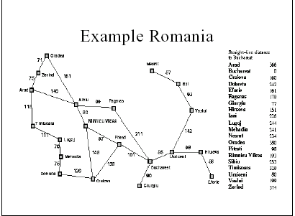

Slide 13
Greedy Search Algorithm
Different variations of best-first search according to function f
Idea: expand node with the smallest estimated cost to reach the goal
Use heuristic function f(n) = h(n)
  Not optimal
  incomplete

Slide 14
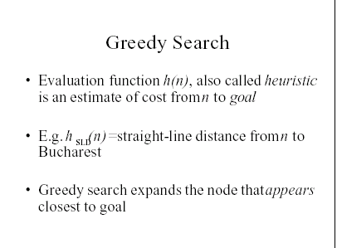

Slide 15
Informed Methods Add
Domain-Specific Information
Add domain-specific information to select what is the best path to continue searching along
Define a heuristic function, h(n), that estimates the "goodness" of a node n with respect to reaching a goal.
Specifically, h(n) = estimated cost (or distance) of minimal cost path from n to a goal state.
h(n) is about cost of the future search, g(n) past search
h(n) is an estimate (rule of thumb), based on domain-specific information that is computable from the current state description. Heuristics do not guarantee feasible solutions and are often without theoretical basis.
minimal path cost = g(n)
estimated minimal path cost = h(n)
root
Current node
goal

Slide 16
Heuristics
Examples:
  8-puzzle: Number of tiles out of place (i.e., not in their goal positions)
In general:
  h(n) >= 0 for all nodes n
  h(n) = 0 implies that n is a goal node
  h(n) = infinity implies that n is a deadend from which a goal cannot be reached

Slide 17
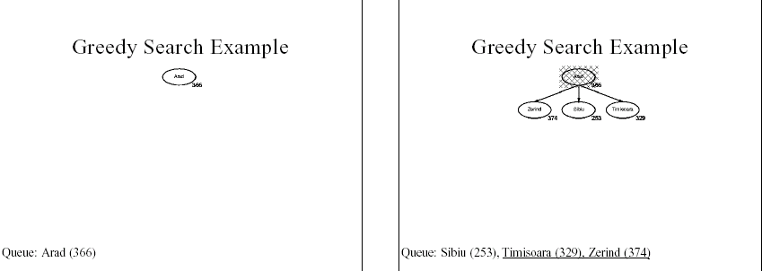

Slide 18
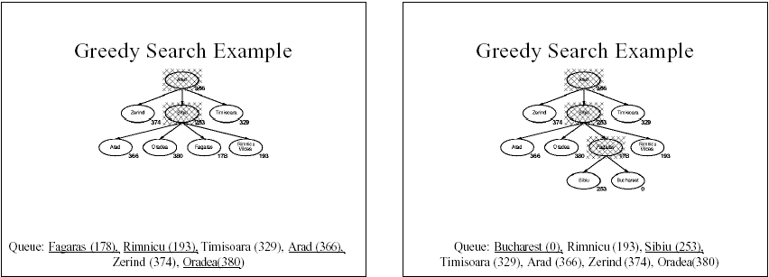

Slide 19
Best First Search
Order nodes on the OPEN list by increasing value of an evaluation function, f(n) , that incorporates domain-specific information in some way.
Example of f(n):
  f(n) = g(n) (uniform-cost)
  f(n) = h(n) (greedy algorithm)
  f(n) = g(n) + h(n) (algorithm A)
This is a generic way of referring to the class of informed methods.

Slide 20
Greedy Search
Evaluation function f(n) = h(n), sorting open nodes by increasing values of f.
Selects node to expand believed to be closest (hence it's "greedy") to a goal node (i.e., smallest f = h value)
Not admissible, as in the example. Assuming all arc costs are 1, then Greedy search will find goal f, which has a solution cost of 5, while the optimal solution is the path to goal i with cost 3.
Not complete (if no duplicate check)
a
h=2
b
g
h=4
c
h
h=1
h=1
d
i
h=0
h=1
e
h=1
h=0
f

Slide 21
Algorithm A
Use as an evaluation function
  f(n) = g(n) + h(n)
The h(n) term represents a “depth-first“ factor in f(n)
g(n) = minimal cost path from the start state to state n generated so far
The g(n) term adds a "breadth-first" component to f(n).
Ranks nodes on OPEN list by estimated cost of solution from start node through the given node to goal.
Completeness and admissibility
depends on h(n)
S
8
5
8
1
1
A
5
B
C
8
9
3
5
1
4
D
G
9
f(D)=4+9=13
f(B)=5+5=10
f(C)=8+1=9
C is chosen next to expand
Notes:
Admissible
The restriction is to choose an h function that never overestimates the cost to reach the goal. Such an h is called an admissible heuristic. Admissible heuristics are by nature optimistic, because they think the cost of solving the problem is less than it actually is. This optimism transfers to the f function as well: If h is admissible, f(n) never overestimates the actual cost of the best solution through n. Best-first search using f as the evaluation function and an admissible function is known as A* search.

Slide 22
Algorithm A
OPEN := {S}; CLOSED := {};
repeat
Select node n from OPEN with minimal f(n) and place n on CLOSED;
if n is a goal node exit with success;
Expand(n);
For each child n' of n do
compute h(n'), g(n')=g(n)+ c(n,n'), f(n')=g(n')+h(n');
  if n' is not already on OPEN or CLOSED then
    put n’ on OPEN; set backpointer from n' to n
  else if n' is already on OPEN or CLOSED and if g(n') is lower for the new version of n' then
    discard the old version of n‘;
    Put n' on OPEN; set backpointer from n' to n
until OPEN = {};
exit with failure

Slide 23
Algorithm A*
Algorithm A with constraint that h(n) <= h*(n)
h*(n) = true cost of the minimal cost path from n to any goal.
g*(n) = true cost of the minimal cost path from S to n.
f*(n) = h*(n)+g*(n) = true cost of the minimal cost solution path from S to any goal going through n.
h is admissible when h(n) <= h*(n) holds.
Using an admissible heuristic guarantees that the first solution found will be an optimal one.
A* is complete whenever the branching factor is finite, and every operator has a fixed positive cost (total # of nodes with f(.) <= f*(goal) is finite)
A* is admissible
Notes:
If algorithm A uses an evaluation function f in which h(n) <= h*(n), it is called algorithm A*

Slide 24
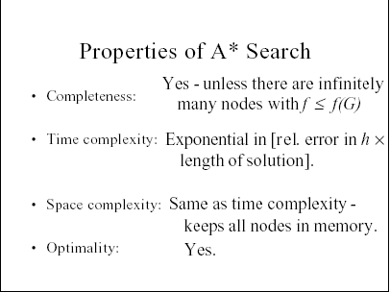

Slide 25
Admissibility of A*
Admissibility provided a solution exists, the first solution found is a optimal solution
Condition for admissibility
  State-space graph
    Every node has a finite number of successor
    Every arc in the graph has a cost greater than some ∈ > 0
    Heuristic function
    For every node n, h(n) < h*(n)

Slide 26
Admissibility of A*
A* is optimally efficient for a given heuristic
If the optimal search algorithms that expand search paths from the new root node, it can be shown that no other optimal algorithm will expand fewer nodes and find a solution
Monotonic heuristic: along any path then f-cost never decreases
If this property does not hold we can use the following trick (m if a child of n)
f(m) = max (f(n), g(m) + h(n)

Slide 27
Example search space
start state
parent pointer
0
S
8
arc cost
1
8
5
1
A
5
B
4
8
C
3
8
3
9
7
4
h value
5
g value
4
D
∞
8
E
∞
9
G
0
goal state

Slide 28
Example
    n g(n) h(n) f(n) h*(n)
    S 0 8 8 9
    A 1 8 9 9
    B 5 4 9 4
    C 8 3 11 5
    D 4 inf inf inf
    E 8 inf inf inf
    G 9 0 9 0
h*(n) is the (hypothetical) perfect heuristic.
Since h(n) <= h*(n) for all n, h is admissible
Optimal path = S B G with cost 9.

Slide 29
Greedy Algorithm
f(n) = h(n)
node exp. OPEN list
{S(8)}
S {C(3) B(4) A(8)}
C {G(0) B(4) A(8)}
G {B(4) A(8)}
Solution path found is S C G with cost 13.
3 nodes expanded.
Fast, but not optimal.

Slide 30
A* Search
f(n) = g(n) + h(n)
node exp. OPEN list
{S(8)}
S {A(9) B(9) C(11)}
A {B(9) G(10) C(11) D(inf) E(inf)}
B {G(9) G(10) C(11) D(inf) E(inf)}
G {C(11) D(inf) E(inf)}
Solution path found is S B G with cost 9
4 nodes expanded.
Still pretty fast. And optimal, too.

Slide 31
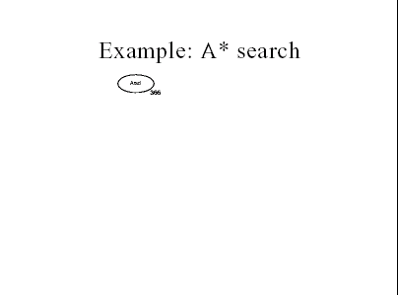

Slide 32
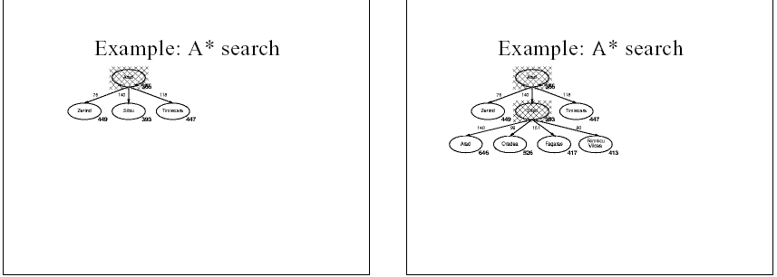

Slide 33
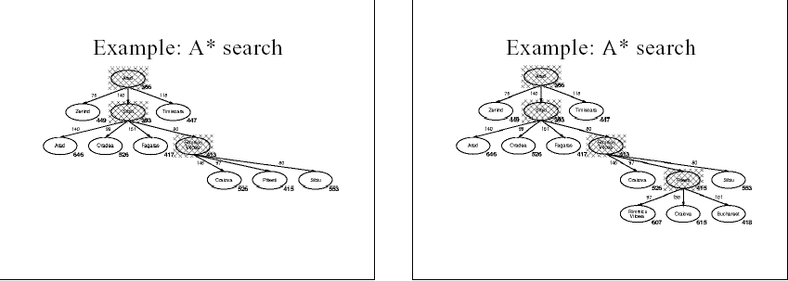

Slide 34
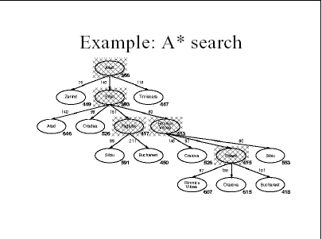

Slide 35
Proof of the Optimality of A*
Let l* be the optimal solution path (from S to G), let f* be its cost
At any time during the search, one or more node on l* are in OPEN
We assume that A* has selected G2, a goal state with a suboptimal solution (g(G2) > f*).
We show that this is impossible.
  Let node n be the shallowest OPEN node on l*
  Because all ancestors of n along l* are expanded, g(n)=g*(n)
  Because h(n) is admissible, h*(n)>=h(n). Then
  f* =g*(n)+h*(n) >= g*(n)+h(n) = g(n)+h(n)= f(n).
  If we choose G2 instead of n for expansion, f(n)>=f(G2).
  This implies f*>=f(G2).
  G2 is a goal state: h(G2) = 0, f(G2) = g(G2).
  Therefore f* >= g(G2)
  Contradiction.

Slide 36
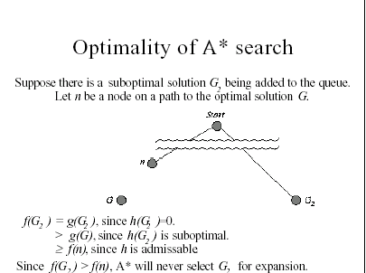

Slide 37
Completeness of A*
Let G be an optimal goal state
A* cann’t reach a goal state only if there are infinitely many nodes where f(n)≤ f*
Can only happen if either happens:
  A node with infinite branching factor
  A path with finite cost but infinitely many nodes

Slide 38
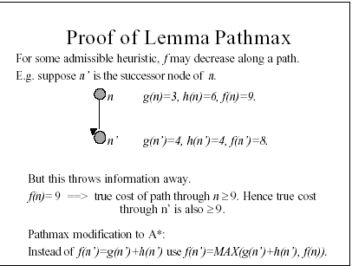
Notes:
monotonicity

Slide 39
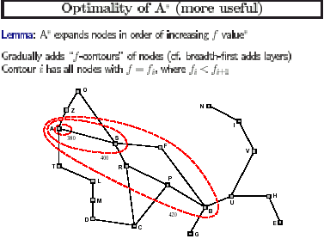

Slide 40
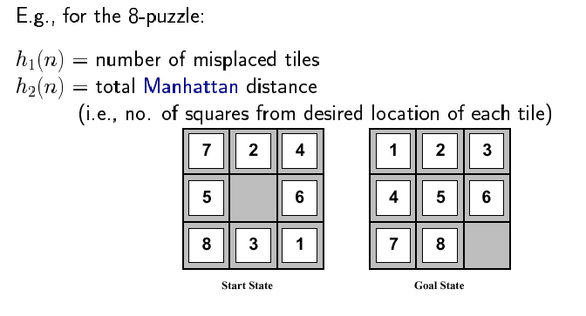
Example of a heuristic:
h₁(n) = 6
h₂(n)= 4+ 0 + 3 + 3 + 1 + 0 + 2 + 1 = 14

Slide 41
Which heuristic function, h₁(n), h₂(n), is better?
In general, a better heuristic function leads you to the solution faster. That is, it requires fewer node expansions.
Effective branching factor : With N node expanded and a goal node reached at depth d, the effective branching factor b satisfies:
For example, if N=14 and d=3, effective branching factor is 2.
A good heuristic should have b close to 1.

Slide 42
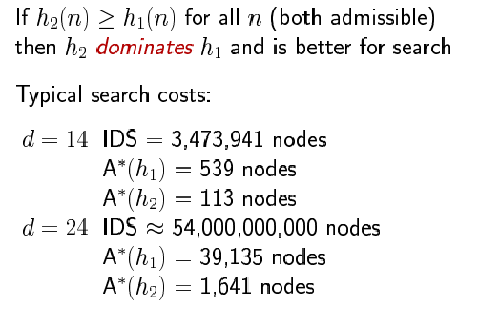
Dominance

Slide 43
Idea:
  Similar to IDDF except now at each iteration the DF search is not bound by the current depth_limit but by the current f_limit
  At each iteration, all nodes with f(n) <= f_limit will be expanded (in DF fashion).
  If no solution is found at the end of an iteration, increase f_limit and start the next iteration
f_limit:
  Initialization: f_limit := h(s)
  Increment: at the end of each (unsuccessful) iteration,
  f_limit := max{f(n)|n is a cut-off node}
Goal testing: test all cut-off nodes until a solution is found
select the least cost one if there are multiple solutions
Admissible if h is admissible
Iterative Deepening A* (IDA*)

Slide 44
IDA* Analysis
Complete and optimal
Space usage proportional to depth of solution
Each iteration is DFS – no priority queue
# nodes expanded relative to A*
  Depends on # unique values of heuristic function

Slide 45
IDA* Analysis
# nodes expanded relative to A*
  In 8-puzzle few values close to
#A* expands
  In travelling salesman, each f value is unique
  1+2+…..n =
A* expands
  If n is too big for main memory, n2 is too long to wait
  Generates duplicate nodes in cyclic graphs

Slide 46

How many more nodes IDA* expand than A*

Slide 47
Memory limited heuristic search
IDA* uses very little memory – linear memory
Other algorithms may use more memory for more efficient search

Slide 48
Recursive BFS
Uses any linear space and mimic best first search (better than IDA*)
It keeps track of the f-value of the best alternative path available from any ancestor of the current node

Slide 49
MA*
MA* and SMA* are restricted memory best first search algorithms that utilize all the memory available
The algorithm executes best first serach while memory is available
When the memory is full the worst node is dropped but the value of the forgoptten node is backed up at the parent

Slide 50
Local Search
Local search methods work on compltet state formulations. They keep only a small number of nodes in memory
Local search is useful for solving optimization problem
  Often it is easy to find a solution
  Buit hard to find the best solution
Algorithm goal:
  Find optimal configuration (e.g. TSP)

Slide 51
Iterative Improvement
In many optimization problem, path is irrel;event, the goal state itself is the solution
  Find configuration satisfying constraints (e.g. n-queens)

Slide 52
Local SEARCH
Iterative methods
  Start with a solution
  Improve it towards a good solution

Slide 53
Example

Slide 54
Hill climbing
Or gradient descent/ascent
Iteratively maximize “value” of current state, by replacing it by successor state that has highest value, as long as possible

Slide 55
Example
Complete state formulation for 8 queens
Successor function: move a single queen to another sqaure in the same column
Cost: number of pairs that are attacking each other
Minimization problem

Slide 56
Hill climbing
Problem: depending on initial state, may get stuck in local extremum

Slide 57
Minimizing energy
Compare our state space to that of a physical system that is subject to natural interactions
Compare our value function to the overall potential energy E of the system
On every updating, we have

Slide 58
Local Minimum Problem

Slide 59
Consequences of occasional ascents

Slide 60
Simulated Annealing
Basic idea: otherwise, do not give up, but instead flip a coin and accept the transition with a given probability (that it lower as the successor is worse
So we accept to sometimes “unoptimise” the value function a little with a non-zero probablity

Slide 61
Iterative Improvement Search
Another approach to search involves starting with an initial guess at a solution and gradually improving it until it is one.
Some examples:
  Hill Climbing – always try to make changes that improve the current state
  Simulated Annealing – sometimes make changes that make things worse, at least temporarily
  Genetic algorithm
Notes:
We saw in Chapter 3 that several well-known problems have the property that the state description itself contains all the information needed for a solution. The path by which the solution is reached is irrelevant. In such cases iterative improvement algorithms often provide the most practical approacg. For example, we start with all 8 queens on the board, or all wires routed through particular channels. Then we might move queens to another to reduce congestion. The general idea is to start with a complete configuration and to make modifications to improve its quality.

Slide 62
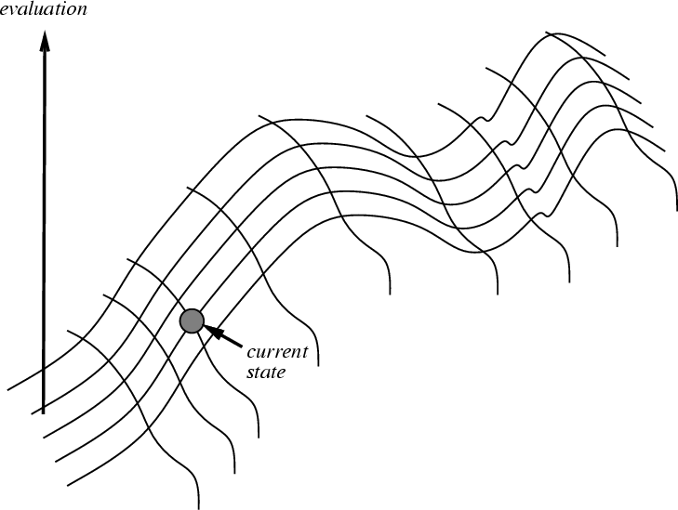
Hill Climbing on a Surface of States
Height Defined by Evaluation Function

Slide 63
Hill Climbing Search
If there exists a successor n’ for the current state n such that
  h(n’) < h(n)
  h(n’) <= h(t) for all the successors t of n,
then move from n to n’. Otherwise, halt at n.
Looks one step ahead to determine if any successor is better than the current state; if there is, move to the best successor.
Similar to greedy search in that it uses h only, but does not allow backtracking or jumping to an alternative path since it doesn’t “remember” where it has been.
OPEN = {current-node}
Not complete since the search will terminate at "local minima," "plateaus," and "ridges."

Slide 64
Hill climbing example
2
8
3
1
2
3
start
1
6
4
h = 4
goal
8
4
h = 0
7
5
7
6
5
5
5
2
2
8
3
1
2
3
1
4
h = 3
8
4
h = 1
7
6
5
7
6
5
3
4
2
3
2
3
1
8
4
1
8
4
h = 2
7
6
5
7
6
5
h = 3
4
f(n) = (number of tiles out of place)

Slide 65
Drawbacks of Hill-Climbing
Problems:
  Local Maximum is a state that is better than all its neighbors but is not better than some other states farther away
  Plateau is a flat area of the search space in which a whole set of neighbouring states have the same value.
  Ridges: is a special kind of local maximum. It is an area of the search space that is higher than surrounding areas and that itself has a slope (which one would like to climb)..
In each case, the algorithm reaches a point at which no progress is being made.
Remedy:
  Backtrack to some earlier node and try going in a different direction
  Start again from a different start point
Some problems spaces are great for Hill Climbing and others horrible.

Slide 66
Example of a local maximum
1
2
5
-4
7
4
start
8
6
3
goal
1
2
5
1
2
5
1
2
4
7
4
7
4
-4
7
3
0
8
6
3
8
6
3
8
6
5
-3
1
2
5
7
4
-4
8
6
3

Slide 67
Example from Knight’s Book
Chapter 3, Section 3.2.2 (Page 68, 69)
First heuristic
    Add one point for every block that is resting on the thing it is supposed to be resting on. Substract one point for every block that is siting on the wrong thing (Local, why show?)
Second heuristic
    For each block that has the correct support structure (i.e. the complete structure underveath it is exactly as it should be) and on epoint for every block in the support structure. For each block that has an incorrect support structure, substract one point for every block in the existing support structure.
Give an example of how local maximum can be overcome by changing heuristic.

Slide 68
Simple Hill Climbing
1. Evaluate the initial state. If it is also goal state, then return it and quit. Otherwise
Continue with the initial state as the current state.
2. Loop until a solution is found or until there are no new operations leff to be applied
in the current state:
(a) Select an operator that has not yet been applied to the current state and
apply it to produce a new state
(b) Evaluate the new state:
i. If it is a goal state, then return it and quit.
ii. If it is not a goal state but it is better than the current state, then make it
the current state
iii. If it is not better than the current state, then continue in the loop.

Slide 69
Steepest-Ascent Hill Climbing
A useful variation on simple hill climbing considers all the moves from the current state and selects the best one as the next state

Slide 70
Compare HC (Steepest –ascent) and BFS
In hill climbing, one move is selected and all the others are rejected, never to be reconsidered.
  This produces the straight line behavior that is characteristics of hill climbing.
In best-first search, one move is selected, but the others are kept around so that they can be revisited later if the selected path becomes less promising
The best available state is selected in best-first search, even if that state has a value that is lower than the value of the state was just explored. This contrast with hill climbing, which will stop if there are no successor states will better values than the current state

Slide 71
Simulated Annealing
Simulated Annealing (SA) exploits an analogy between the way in which a metal cools and freezes into a minimum energy crystalline structure (the annealing process) and the search for a minimum in a more general system.
Each state n has an energy value f(n), where f is an evaluation function
SA can avoid becoming trapped at local minimum energy state by introducing randomness into search so that it not only accepts changes that decreases state energy, but also some that increase it.
SAs use a a control parameter T, which by analogy with the original application is known as the system “temperature” irrespective of the objective function involved.
T starts out high and gradually (very slowly) decreases toward 0.
Notes:
Instead of starting again randomly when suck on a local maximum, we could allow the search to take some downhill steps to escape the local maximum. This is roughly the idea of simulated annealing

Slide 72
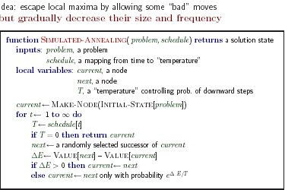

Slide 73

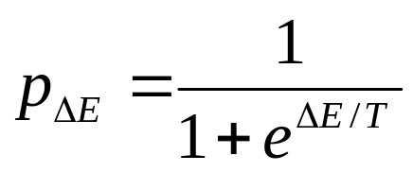
Algorithm for Simulated Annealing
current := a randomly generated state;
T := T_0 /* initial temperature T0 >>0 */
forever do
if T <= T_end then return current;
next := a randomly generated new state; /* next != current */
= f(next) – f(current);
current := next with probability ;
T := schedule(T); /* reduce T by a cooling schedule */
Commonly used cooling schedule
  T := T * alpha where 0 < alpha < 1 is a cooling constant
  T_k := T_0 / log (1+k)

Slide 74
Informed Search Summary
Best-first search is general search where the minimum cost nodes (according to some measure) are expanded first.
Greedy search uses minimal estimated cost h(n) to the goal state as measure. This reduces the search time, but the algorithm is neither complete nor optimal.
A* search combines uniform-cost search and greedy search: f(n) = g(n) + h(n) and handles state repetitions and h(n) never overestimates.
  A* is complete, optimal and optimally efficient, but its space complexity is still bad.
  The time complexity depends on the quality of the heuristic function.
  IDA* reduces the memory requirements of A*.
Hill-climbing algorithms keep only a single state in memory, but can get stuck on local optima.
Simulated annealing escapes local optima, and is complete and optimal given a slow enough cooling schedule (in probability).
Genetic algorithms escapes local optima, and is complete and optimal given a long enough evolution time and large population size.

Slide 75
Assignment
Discuss and compare hill climbing and best-first search techniques
Give an example of an admissible heuristic for the eight puzzle.
Give three different heuristics for an h*(n) to be solved in solving the eight puzzle.
Prove A* is admissible. Hint: the proof should show that:
    A* search will terminate
    During its execution there is always a node on Open that lies on an optimal path to the goal
    If there is a path to goal, A* will terminate by finding the optimal path
Does admissibility imply monotonicity of a heuristic? If not, can you describe when admissibility would imply monotonicity?
Prove that the set of states expanded by algorithm A* is a subset of those examined by breadth-first search
When would best-first search be worse than simple breadth-first search?

